Slide 1
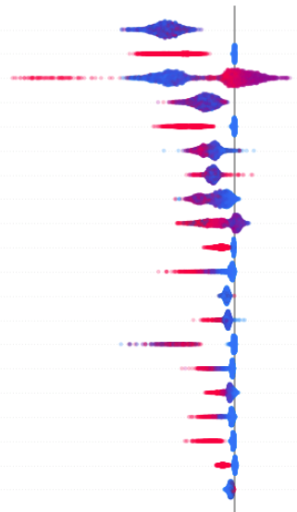
Mortality Prediction & Interpretation
Nilay Pradhan, Priyanka Sabale, Raghu Soorianarayanan, Suman Paladugu
CS-109A: Group 111
Fall 2020

Slide 2
Project Goal
Understand the significant factors that increase mortality risk
Build a model to identify the factors that play a major role in increasing a person’s risk of dying
Make the model more explainable to the medical community where interpretation of the data is more important.

Slide 3
Data
Pre-processed data from NHANES1 study that took place during 1971-75 and follow-up studies done until 1993
Data collected on indicators of the nutritional and health status of participants
Involves physical measurements, clinical assessments and biochemical tests
Data contains information of 9931 participants from Age 25-74

Slide 4
Data pre-processing/preparation
Target variable interpretation
Data imputation on missing data
Identifying race and sex categories
Adding flags indicating predictors outside of normal range

Slide 5
Exploratory Data Analysis

Slide 6
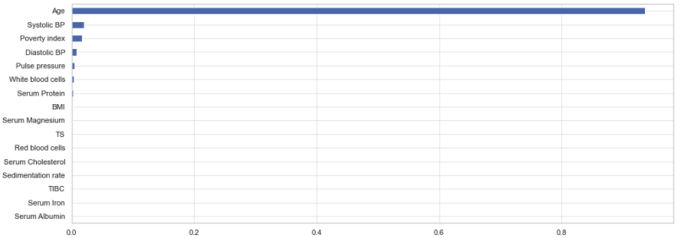
Baseline Model
Bagging model with 30 bootstraps and 3-depth decision tree
Feature Importance

Slide 7
Models explored
Random Forest
AdaBoost
XGBoost

Slide 8
Results
AUC
Accuracy
Model | AUC
Random Forest
AdaBoost
XGBoost

Slide 9
SHAP Interpretation
Local feature importance

Slide 10
SHAP Interpretation
Global feature importance

Slide 11
SHAP Interpretation
Feature Interaction

Slide 12
Conclusions

Slide 13
Next Steps

